Slide 1

Mini Command cart
: Group 42
黃志偉 109000162
許媄香 109000168

Slide 2


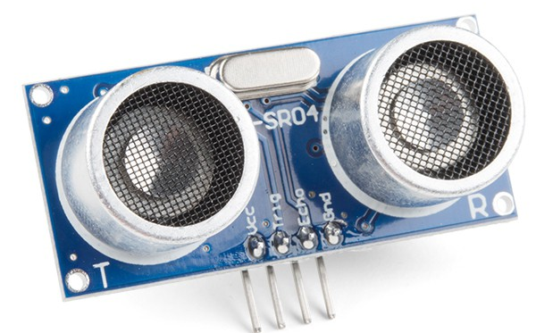
Design concept
Hand Movement Tracing
The Cart will follow the hand movement using sensors signal and move accordingly

Slide 3

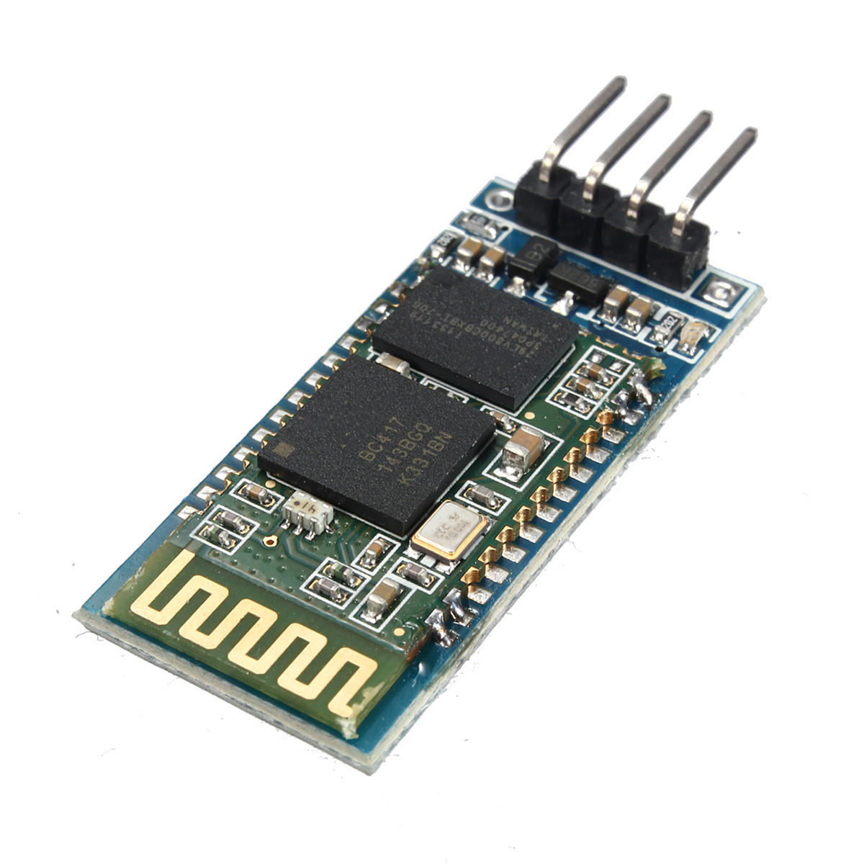


Design Concept
Voice control

Slide 4
appliances
Hardware :
HC - 06 Bluetooth module ( x1 )
L298N ultrasonic sensor ( x1 )
Flying fish IR sensor ( x4 )
FPGA board
Motor module
Car kits
Battery
Dupont wires
Software :
- Arduino Voice Control App

Slide 5
Work distribution
黃志偉
Top module -
Buy materials -
IR sensor control -
許媄香
Top module
Sonic module
Motor module
Bluetooth control
Buy materials

Slide 6
Difficulties
Test

Slide 7
Demonstration
Test

